Slide 1
Semantics
“ An Introduction to Linguistic:-Syal & Jindal

Slide 2
Semantic
Study of meaning in Language
How is Language organised in order to be meaningful
Semantic is the level of linguistic analysis where meaning is analysed

Slide 3
What is Meaning
An Intrinsic property of some thing
Other word related to that word in a Dictionary
Connotation of words- “an idea or feeling which a word invokes for a person in addition to its literal or primary meaning.
"the word ‘discipline’ has unhappy connotations of punishment and repression“”
Things to which the speaker of that word refers
Things to which the speaker of that word should refers
The things to which the speaker of that word belives himself to be referring

Slide 4
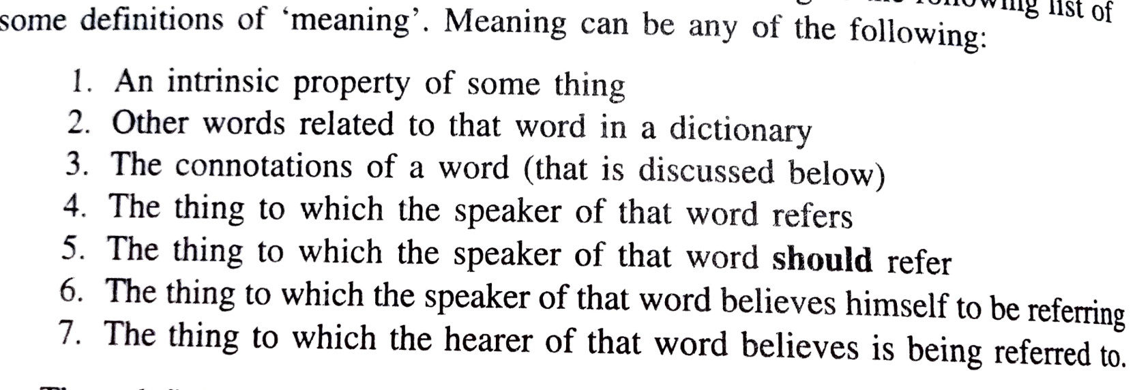

Slide 5
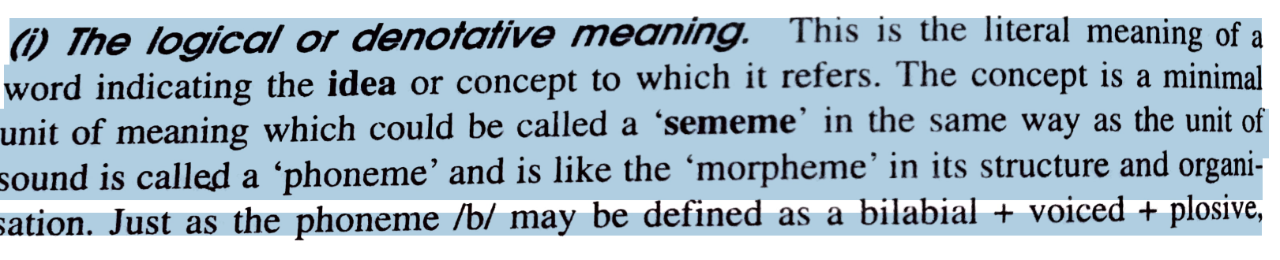
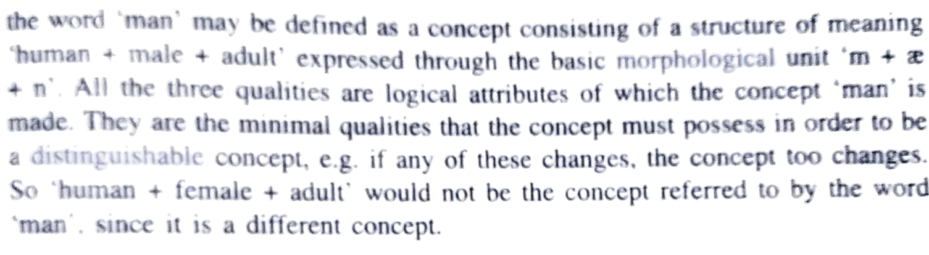
Different aspect of Meaning

Slide 6
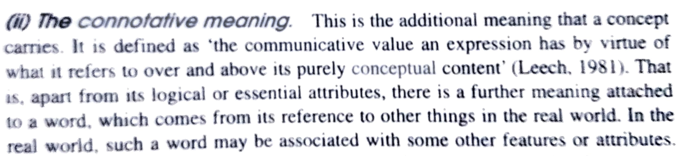
Eg. Man- Connotative meaning could be – Strong, less emotion, active

Slide 7
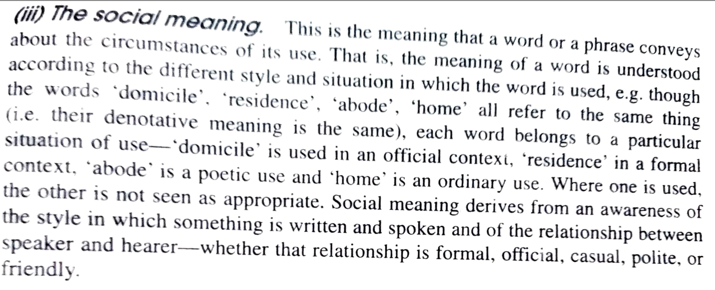

Slide 8
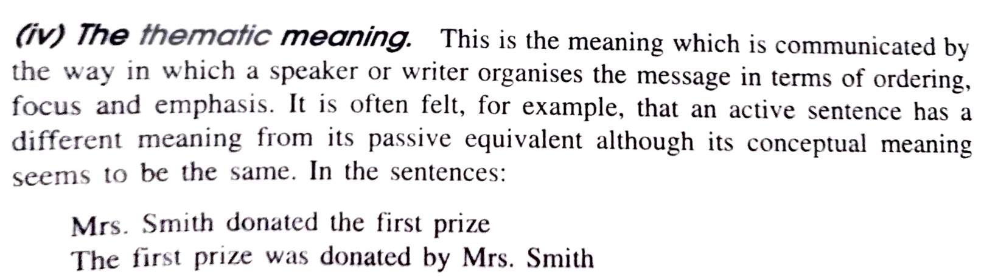

Slide 9
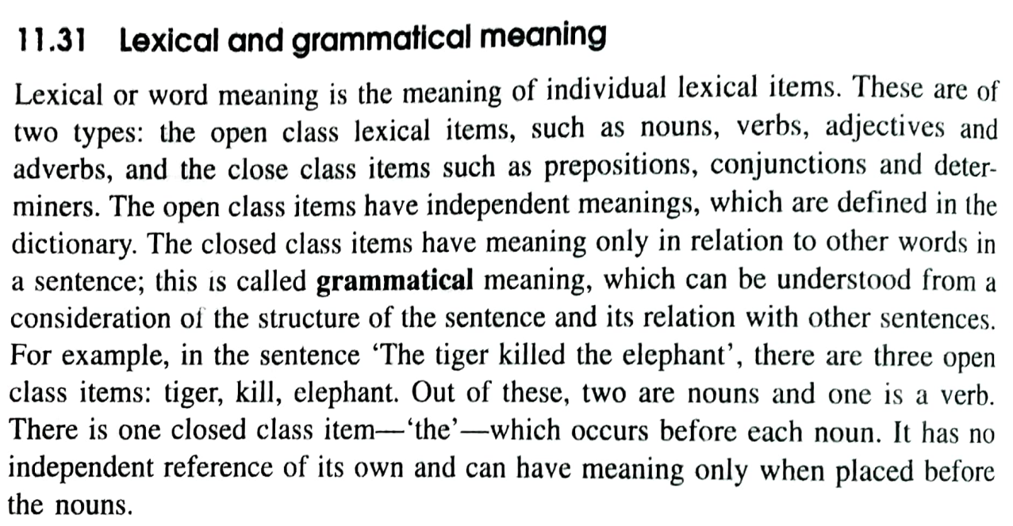
Some terms and Distinctions in semantics

Slide 10
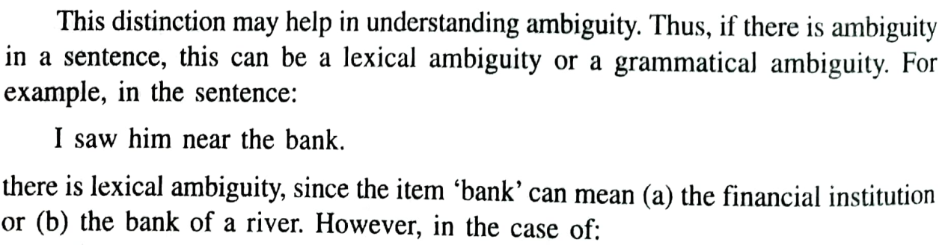

Slide 11
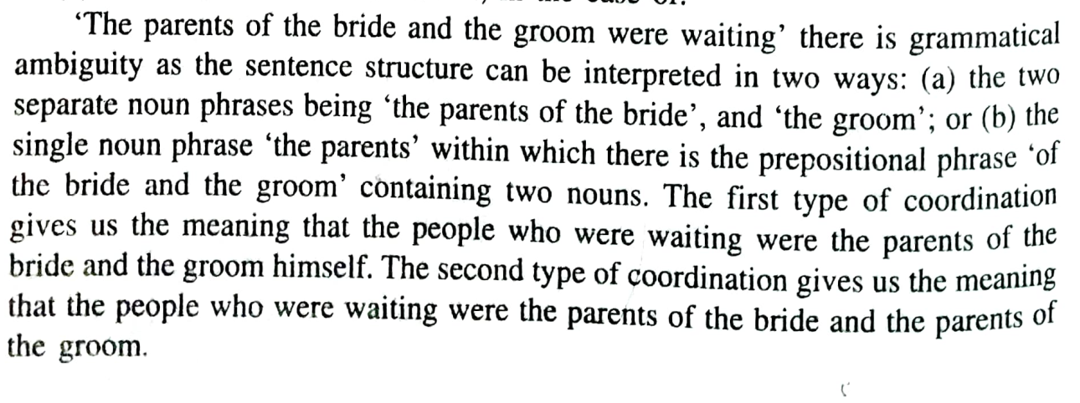

Slide 12
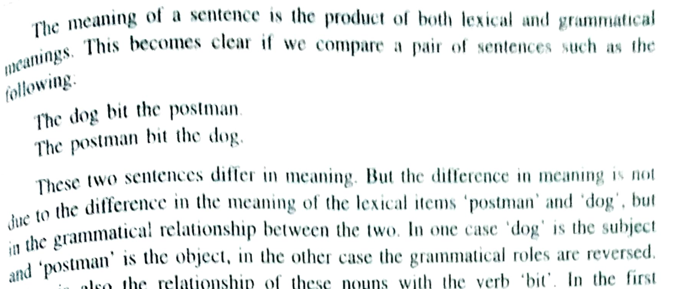

Slide 13
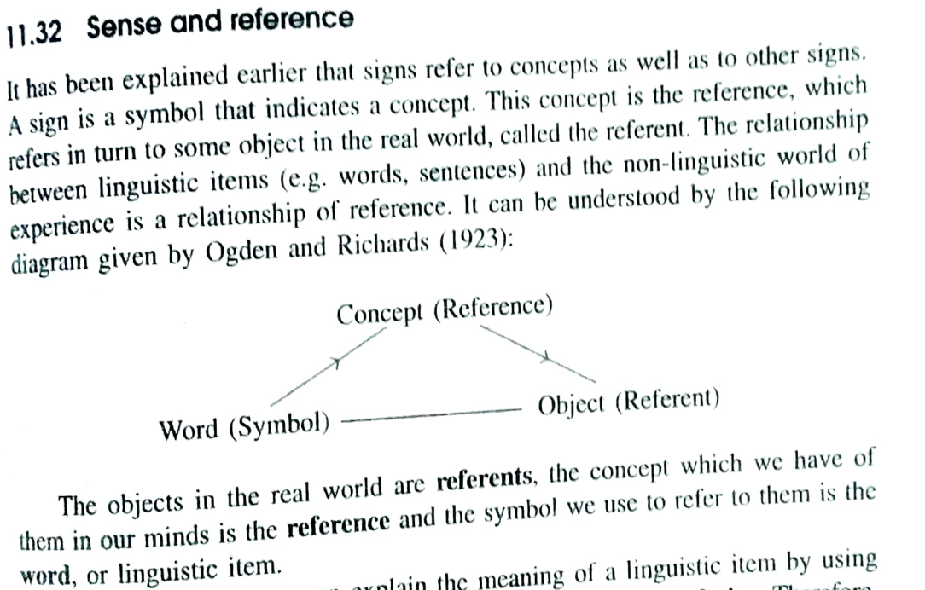

Slide 14
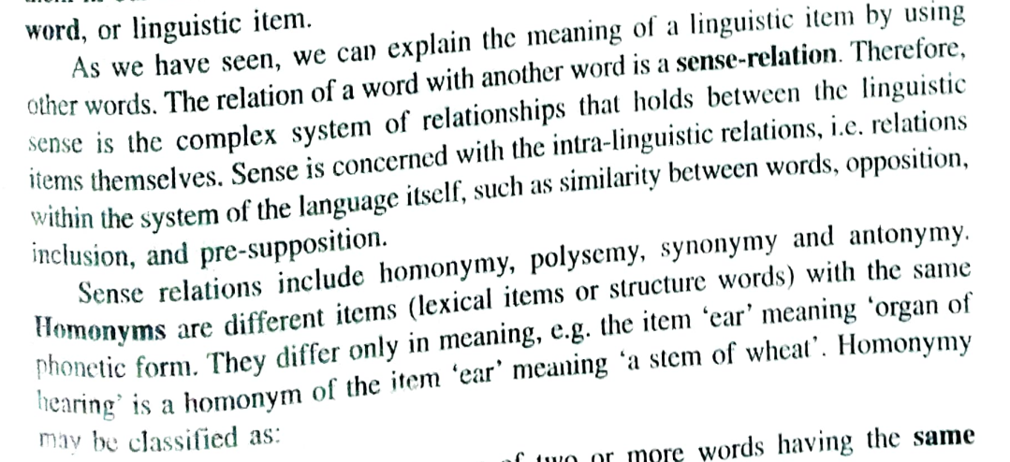
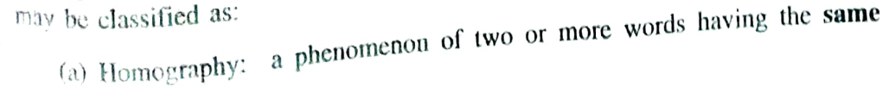

Slide 15
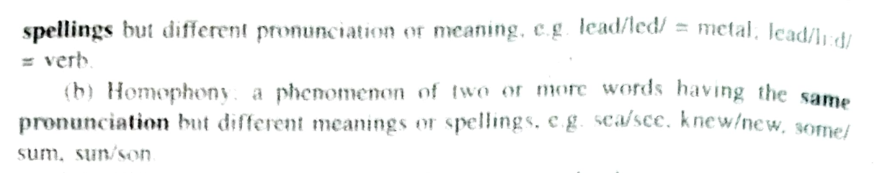
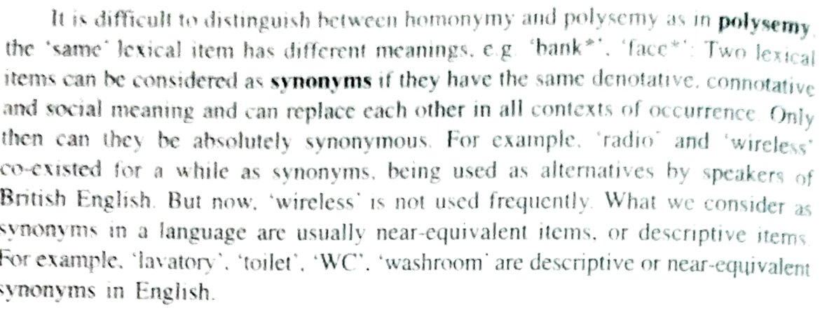

Slide 16
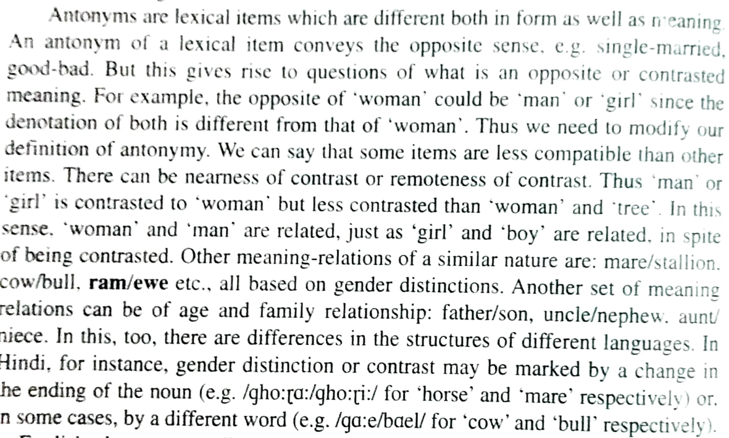

Slide 17
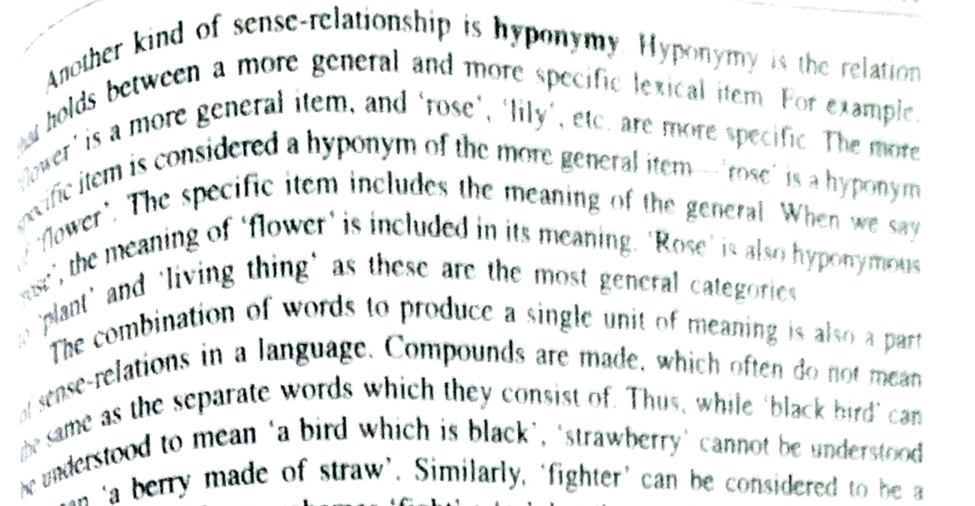

Slide 18
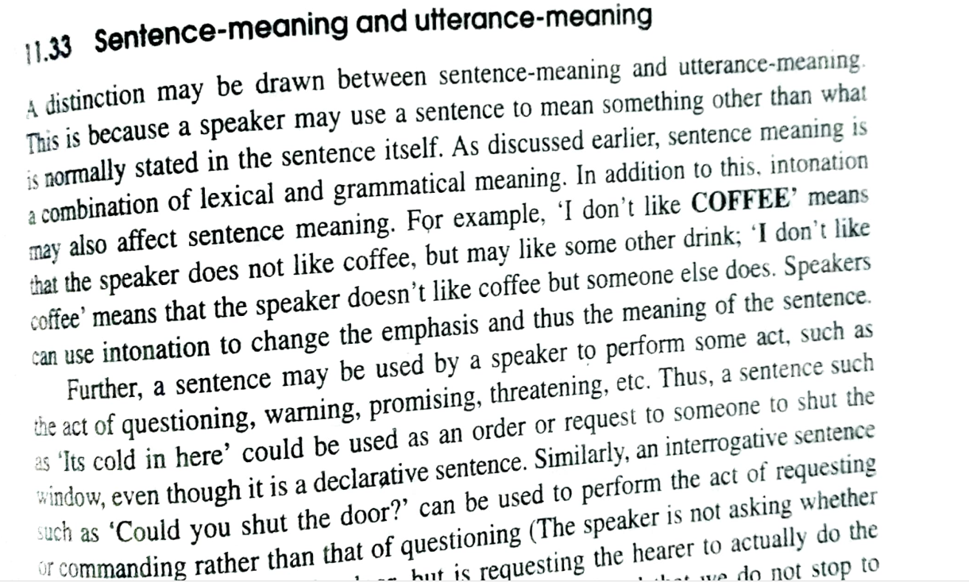

Slide 19
